Slide 1
Assignment 3 Writeup DO NOT TAG
Name: Ken Chen
GT Email: kchen351@gatech.edu

Slide 2
Visualization
DO NOT TAG

Slide 3
Implementation Question 1 DO NOT TAG
In your coding homework, you were given the following hint:
“There are two approaches to performing backprop using the PyTorch command tensor.backward()… Alternatively, one can take the sum of all the elements of the tensor and do a single backprop with the resulting scalar. This second approach is simpler and preferable as it lends itself vectorization.”
Question: Referring to the coding task completed by you, why is the suggested alternative approach mathematically sound? Please provide a brief but succinct answer on the next slide.

Slide 4
Answer for Implementation Question 1
Answer:
What backwards() gives is d(loss)/d(parameter) and I expect a single gradient value per parameter/variable. Had the loss function been a vector function, I would have ended up with multiple gradients per parameter/variable. The sum of the gradients is the gradient of the sum.

Slide 5
Implementation Question 2 DO NOT TAG
In your network visualization tasks, you need to compute gradients for which one of the following three quantities:
Cross entropy loss
Unnormalized score corresponding to the correct class
Class probabilities
Please answer on the next slide.
Now briefly justify why the other two options are not optimal.

Slide 6
Answer for Implementation Question 2
Answer (A, B or C): B
Now briefly justify why the other two options are not optimal for tasks on hand.
The maximisation of the class posterior can be achieved by minimising the scores of other classes. Therefore, we optimise unnormalized class scores to ensure that the optimisation concentrates only on the certain clas.

Slide 7
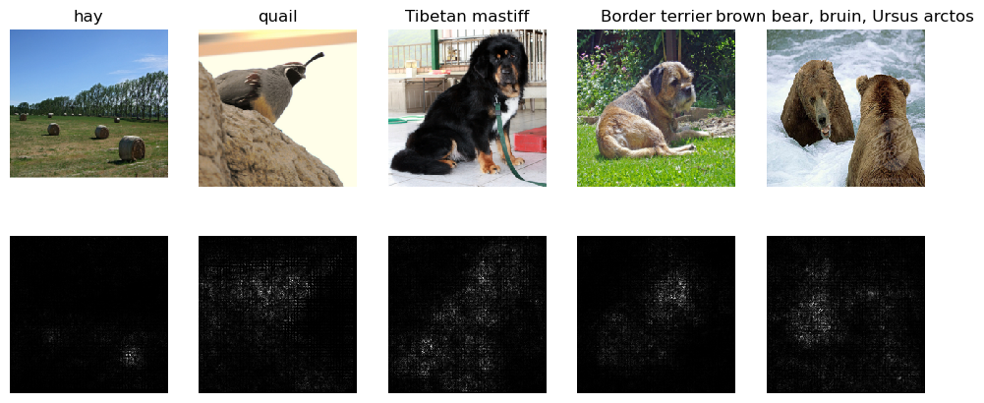
Saliency Map
Include your saliency map here

Slide 8
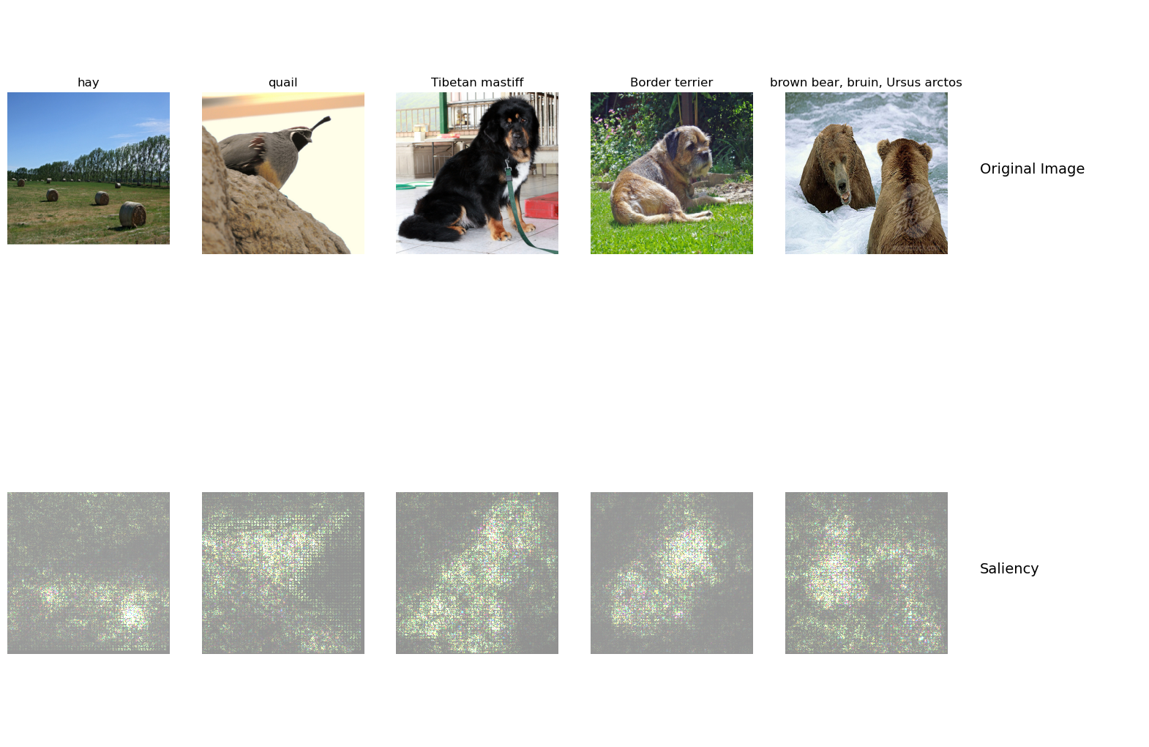
Saliency Map
Include your saliency map from Captum here

Slide 9
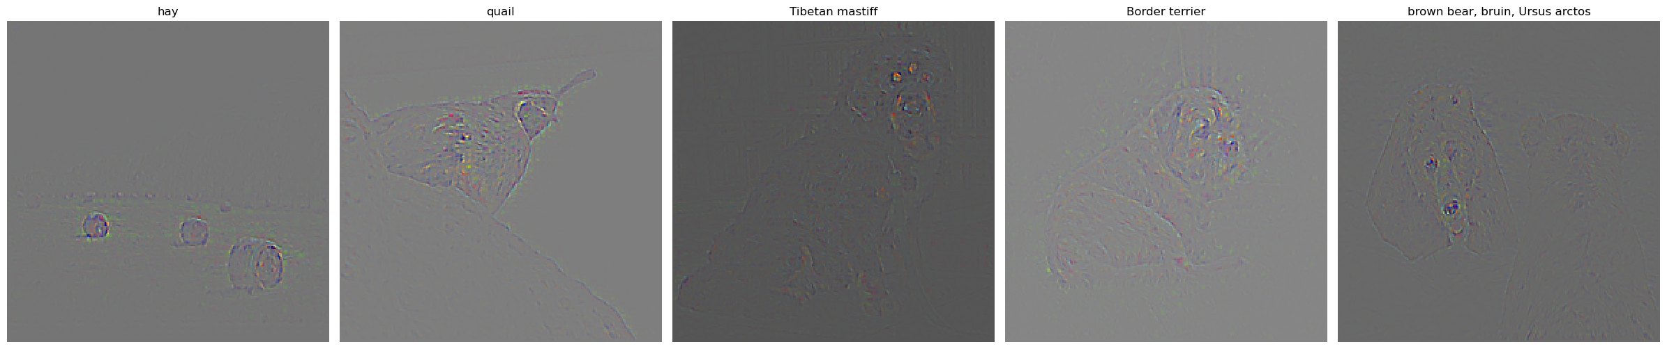
GradCam
Include your visualization of Guided Backprop here

Slide 10
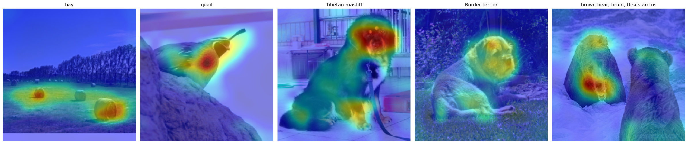
GradCam
Include your visualization of GradCam here

Slide 11
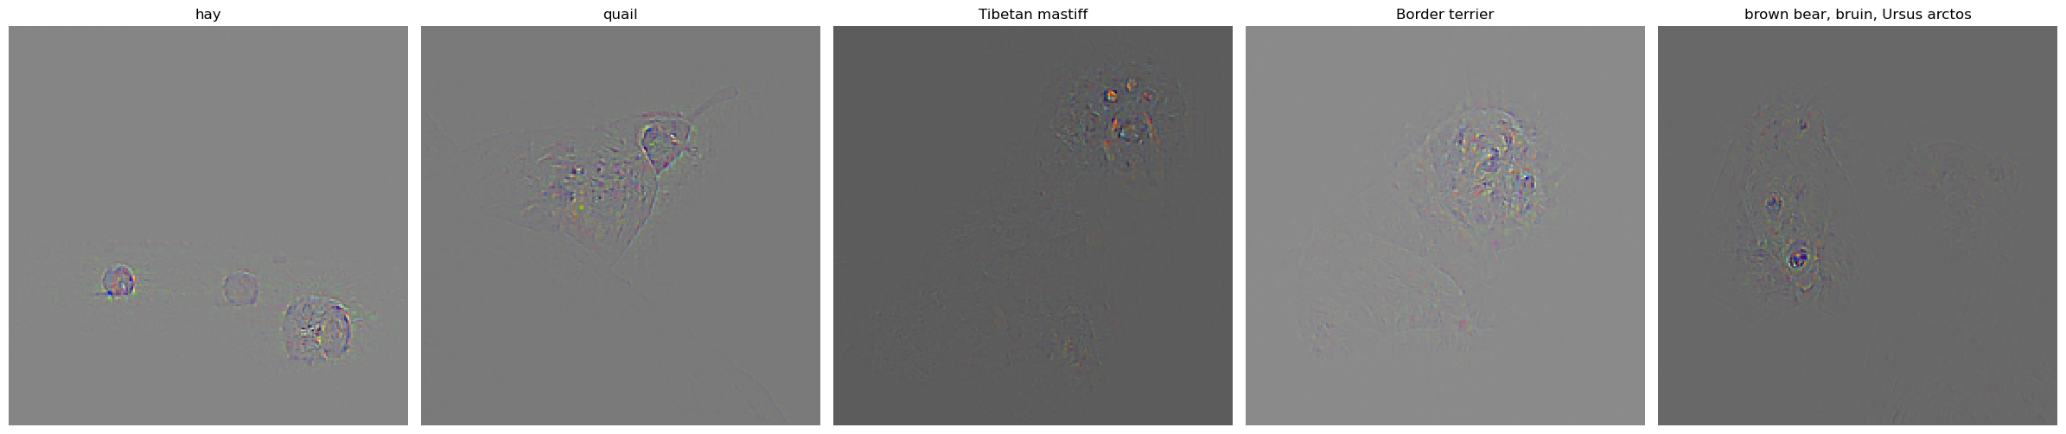
GradCam
Include your visualization of Guided GradCam here

Slide 12
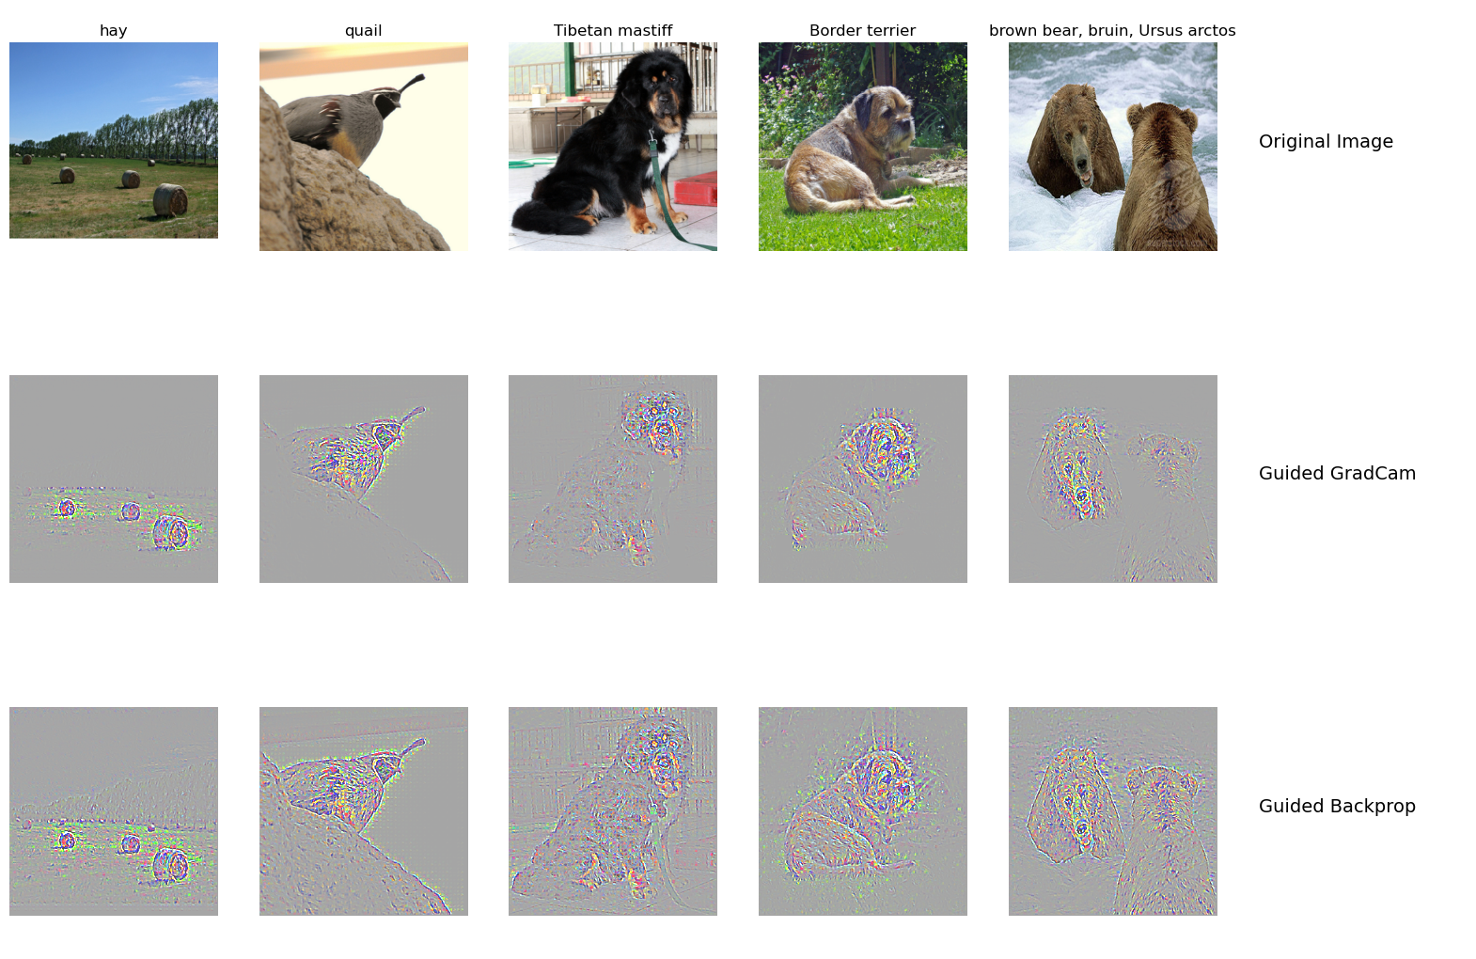
GradCam
Include your visualization of Guided Backprop and Guided Gradcam from Captum here

Slide 13
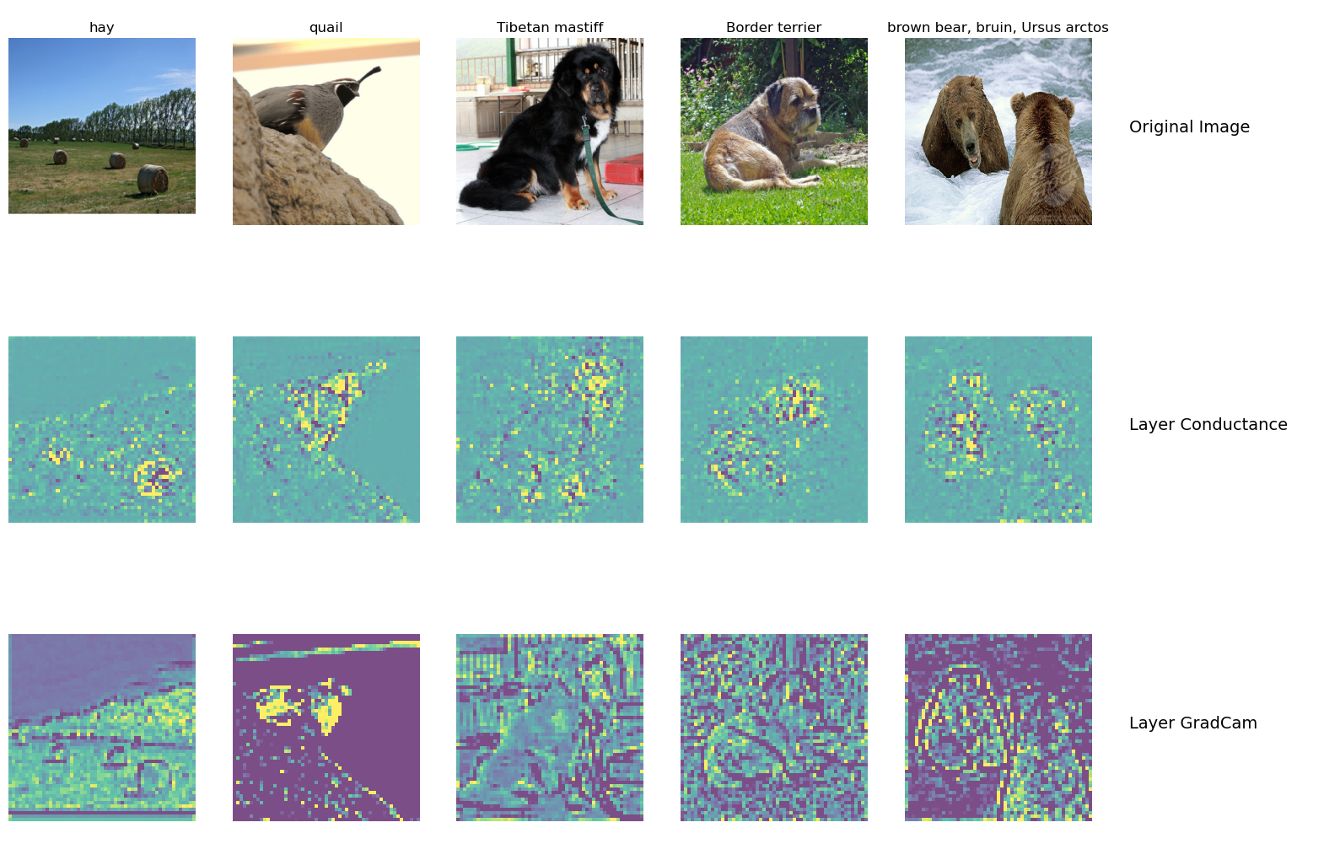
GradCam
Visualization of layers and neurons using Captum here:

Slide 14
What do saliency map and Gradcam tell you? How are they different? Is one better than the other?
Answer:
They both tell us which parts of the image contribute to which degree to layers, or to the overall classification outcome. They tell us the relative importance of different pixels for specific classification tasks. Viewed another way, they tell us the degree to which different pixels elicit activation of various filters or even neurons. In many of the example images, the greatest activations seem to occur around animal. Gradcam uses the gradient of any target concept, flows into the final convolutional layer and generates a rough positioning map to highlight the use of the image. So I think gradcam seams better.

Slide 15
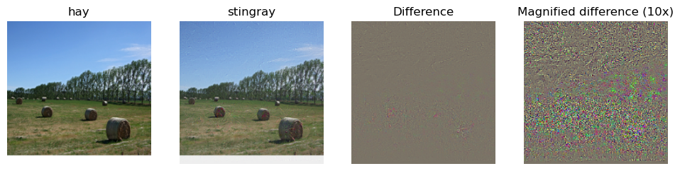
Fooling Image
Include the fooling image here

Slide 16
Fooling Image
What insights do you get from fooling images:
Answer:
The fooling image adjusts the picture to make it able to fool the trained network, with iteratively update the input picture with the gradient of the target classification to the input picture.
The featurs captured by the network are very different from humans. We understand which pixels have a greater impact on the prediction results. By adding some noise that is hard for human to detect, it can significantly interfere with the predictions.
We can use fooling image to train the network to make the model more robust.

Slide 17
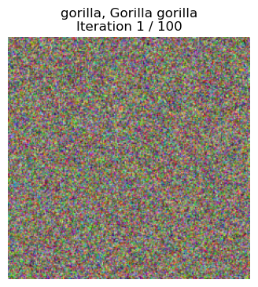
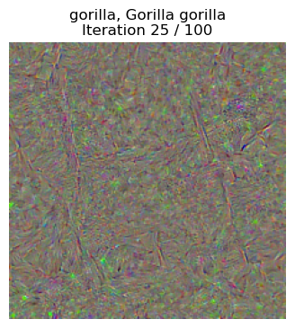
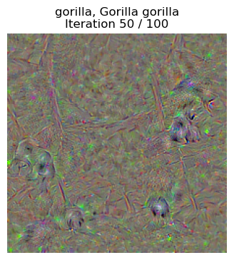
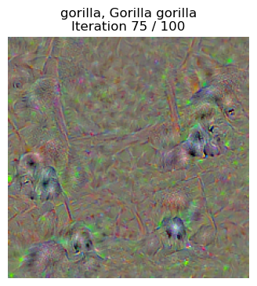
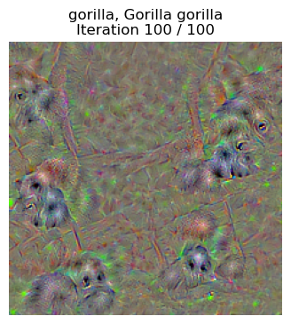
Class Visualization
Include class visualization of Gorilla here

Slide 18
Question: Class Visualization – Use saliency?
In order to find an image that maximizes the correct score, Jane performs gradient ascent on the input image, but instead of the gradient she uses the saliency map in each step to update the image. List and briefly explain two reasons why this is an incorrect approach. (Hint: refer to Section 1.1 of the assignment pdf)
Answer:
The saliency map uses the absolute value of gradients. So Jane is not able to run gradient ascending without knowing the sign of the gradients.
The saliency map is the maximum value across absolute gradients over input channels only but Jane need to maximize the the loss over the entire image.

Slide 19
Question: Class Visualization – Regularization DO NOT TAG
When generating an image that the network will recognize as the target class, the quality of the generated image is improved by regularization. In your work, you applied L2-regularization and blurring for this purpose. What is the effect of these on the optimization process (that is, what is it that these techniques are discouraging)?
Please answer on the next slide.

Slide 20
Answer for Class Visualization – Regularization
Answer
The techniques are discouraging extreme values and big variance for the images, making the image smoother.

Slide 21
Style Transfer
DO NOT TAG

Slide 22
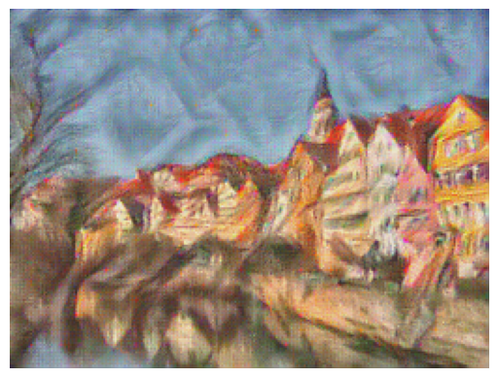
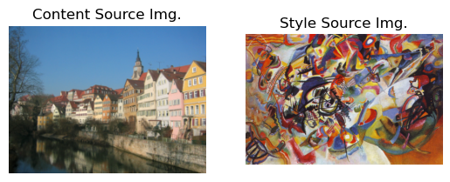
Composition VII + Tubingen
Include both original images and the transferred image

Slide 23
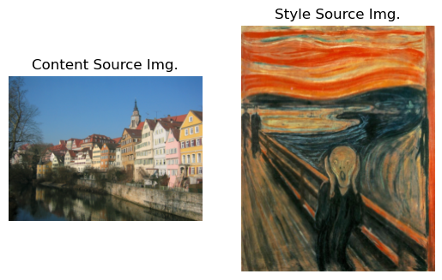
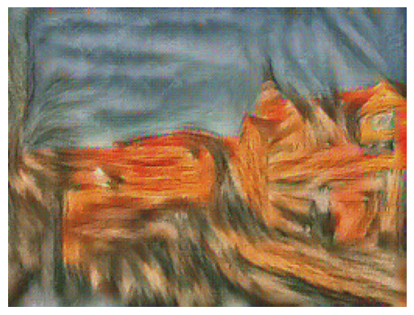
Scream + Tubingen
Include both original images and the transferred image

Slide 24
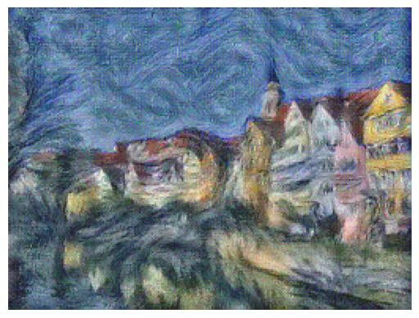
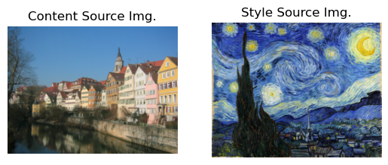
Starry Night + Tubingen
Include both original images and the transferred image

Slide 25
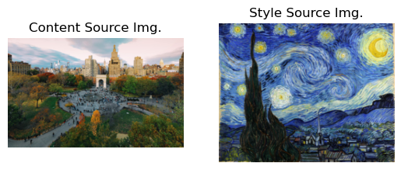
Style Transfer – Unleash Your Creativity
Include your two original images (content and style images)

Slide 26
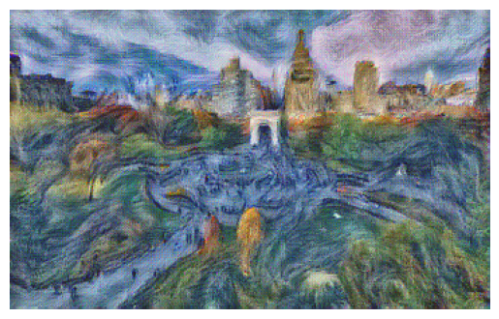
Style Transfer – Unleash Your Creativity
Include your final stylized image

